Slide 1
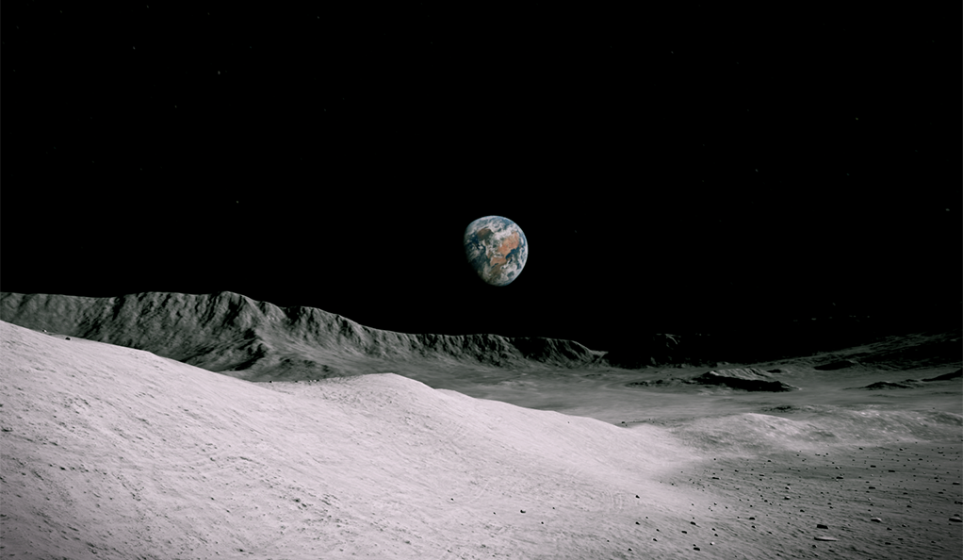
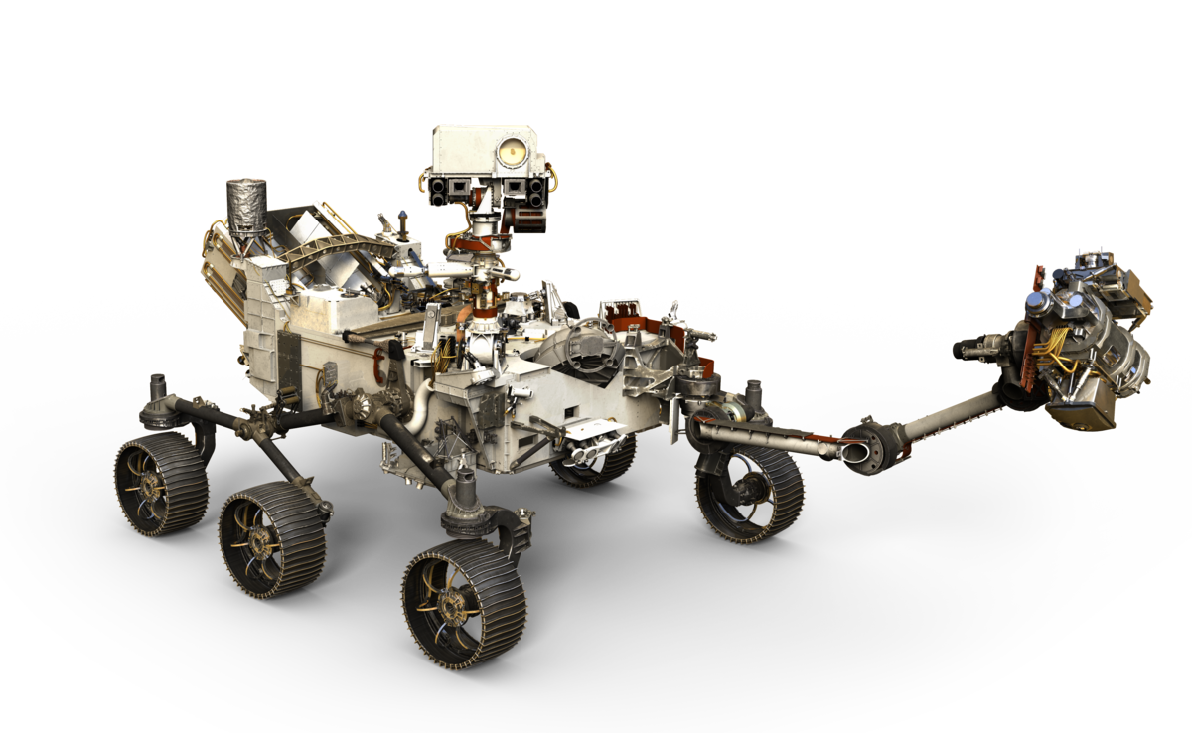
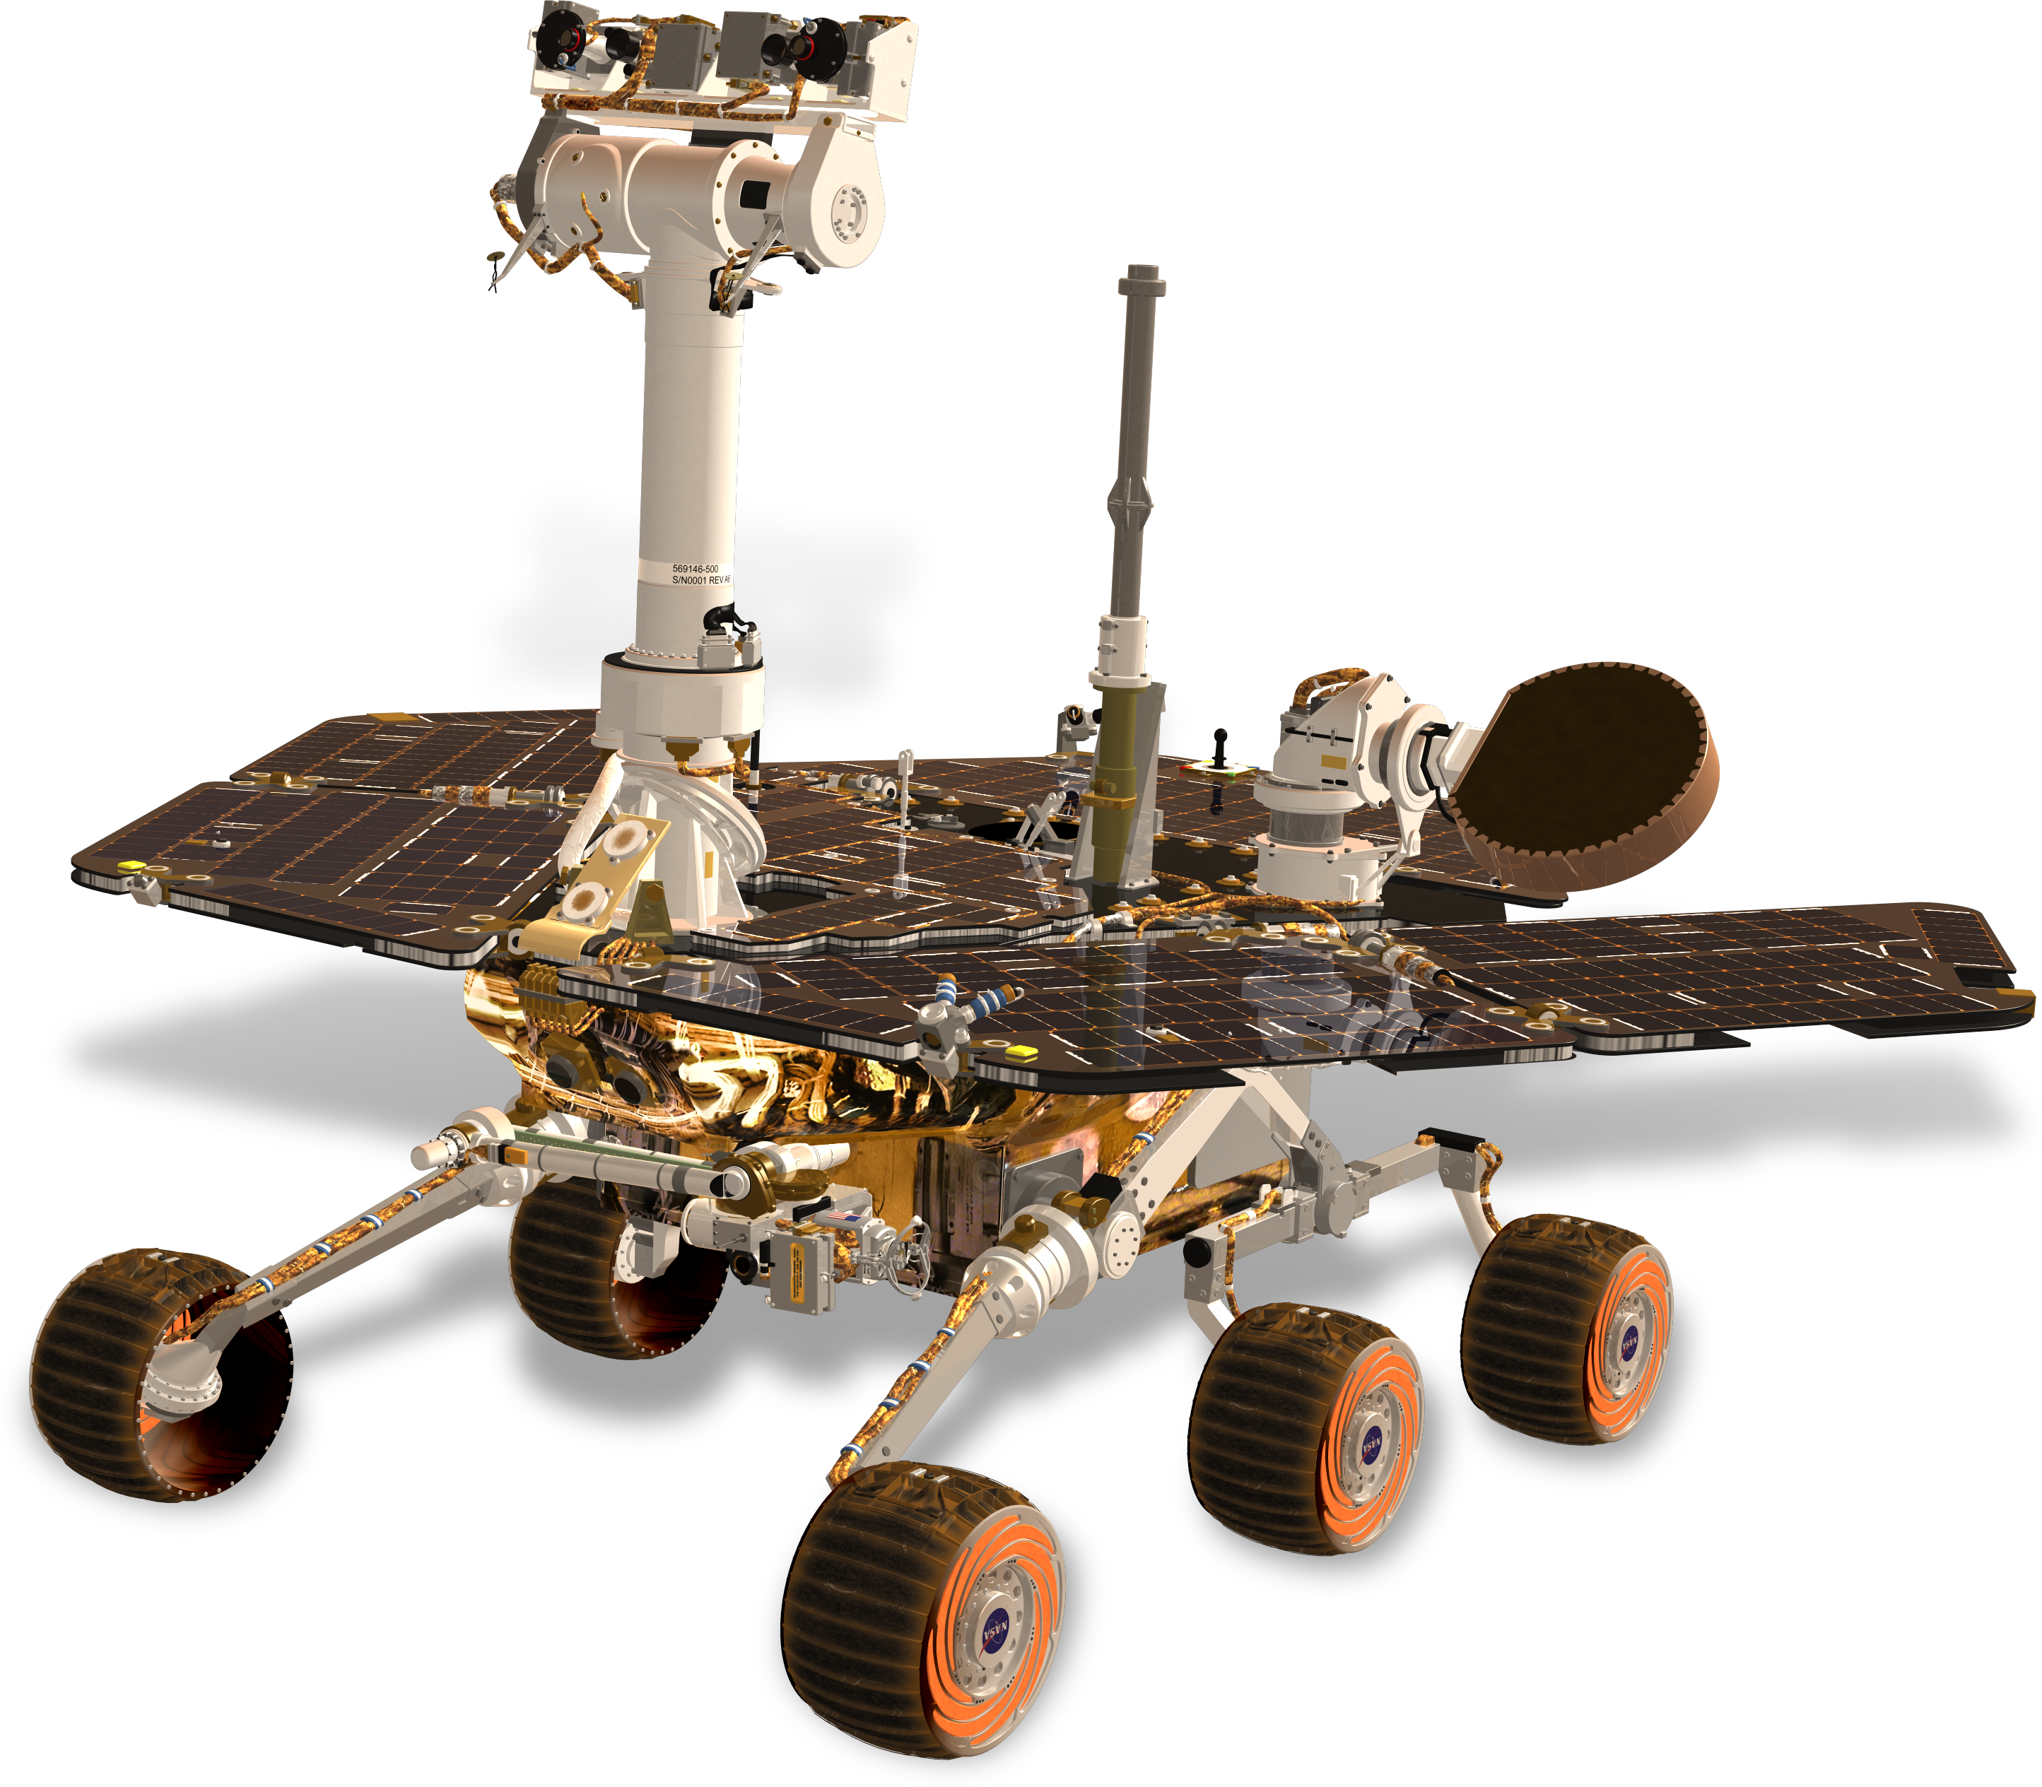
Team 517
Virtual Design Review 1
Cameron Barnes | Cole Gutknecht | Tyler Ince-Ingram| Rafael Meza | Michael Wyrick
Notes:
Hi everyone, we are Senior Design Team 517 and we are presenting on our project progress so far this semester

Slide 2



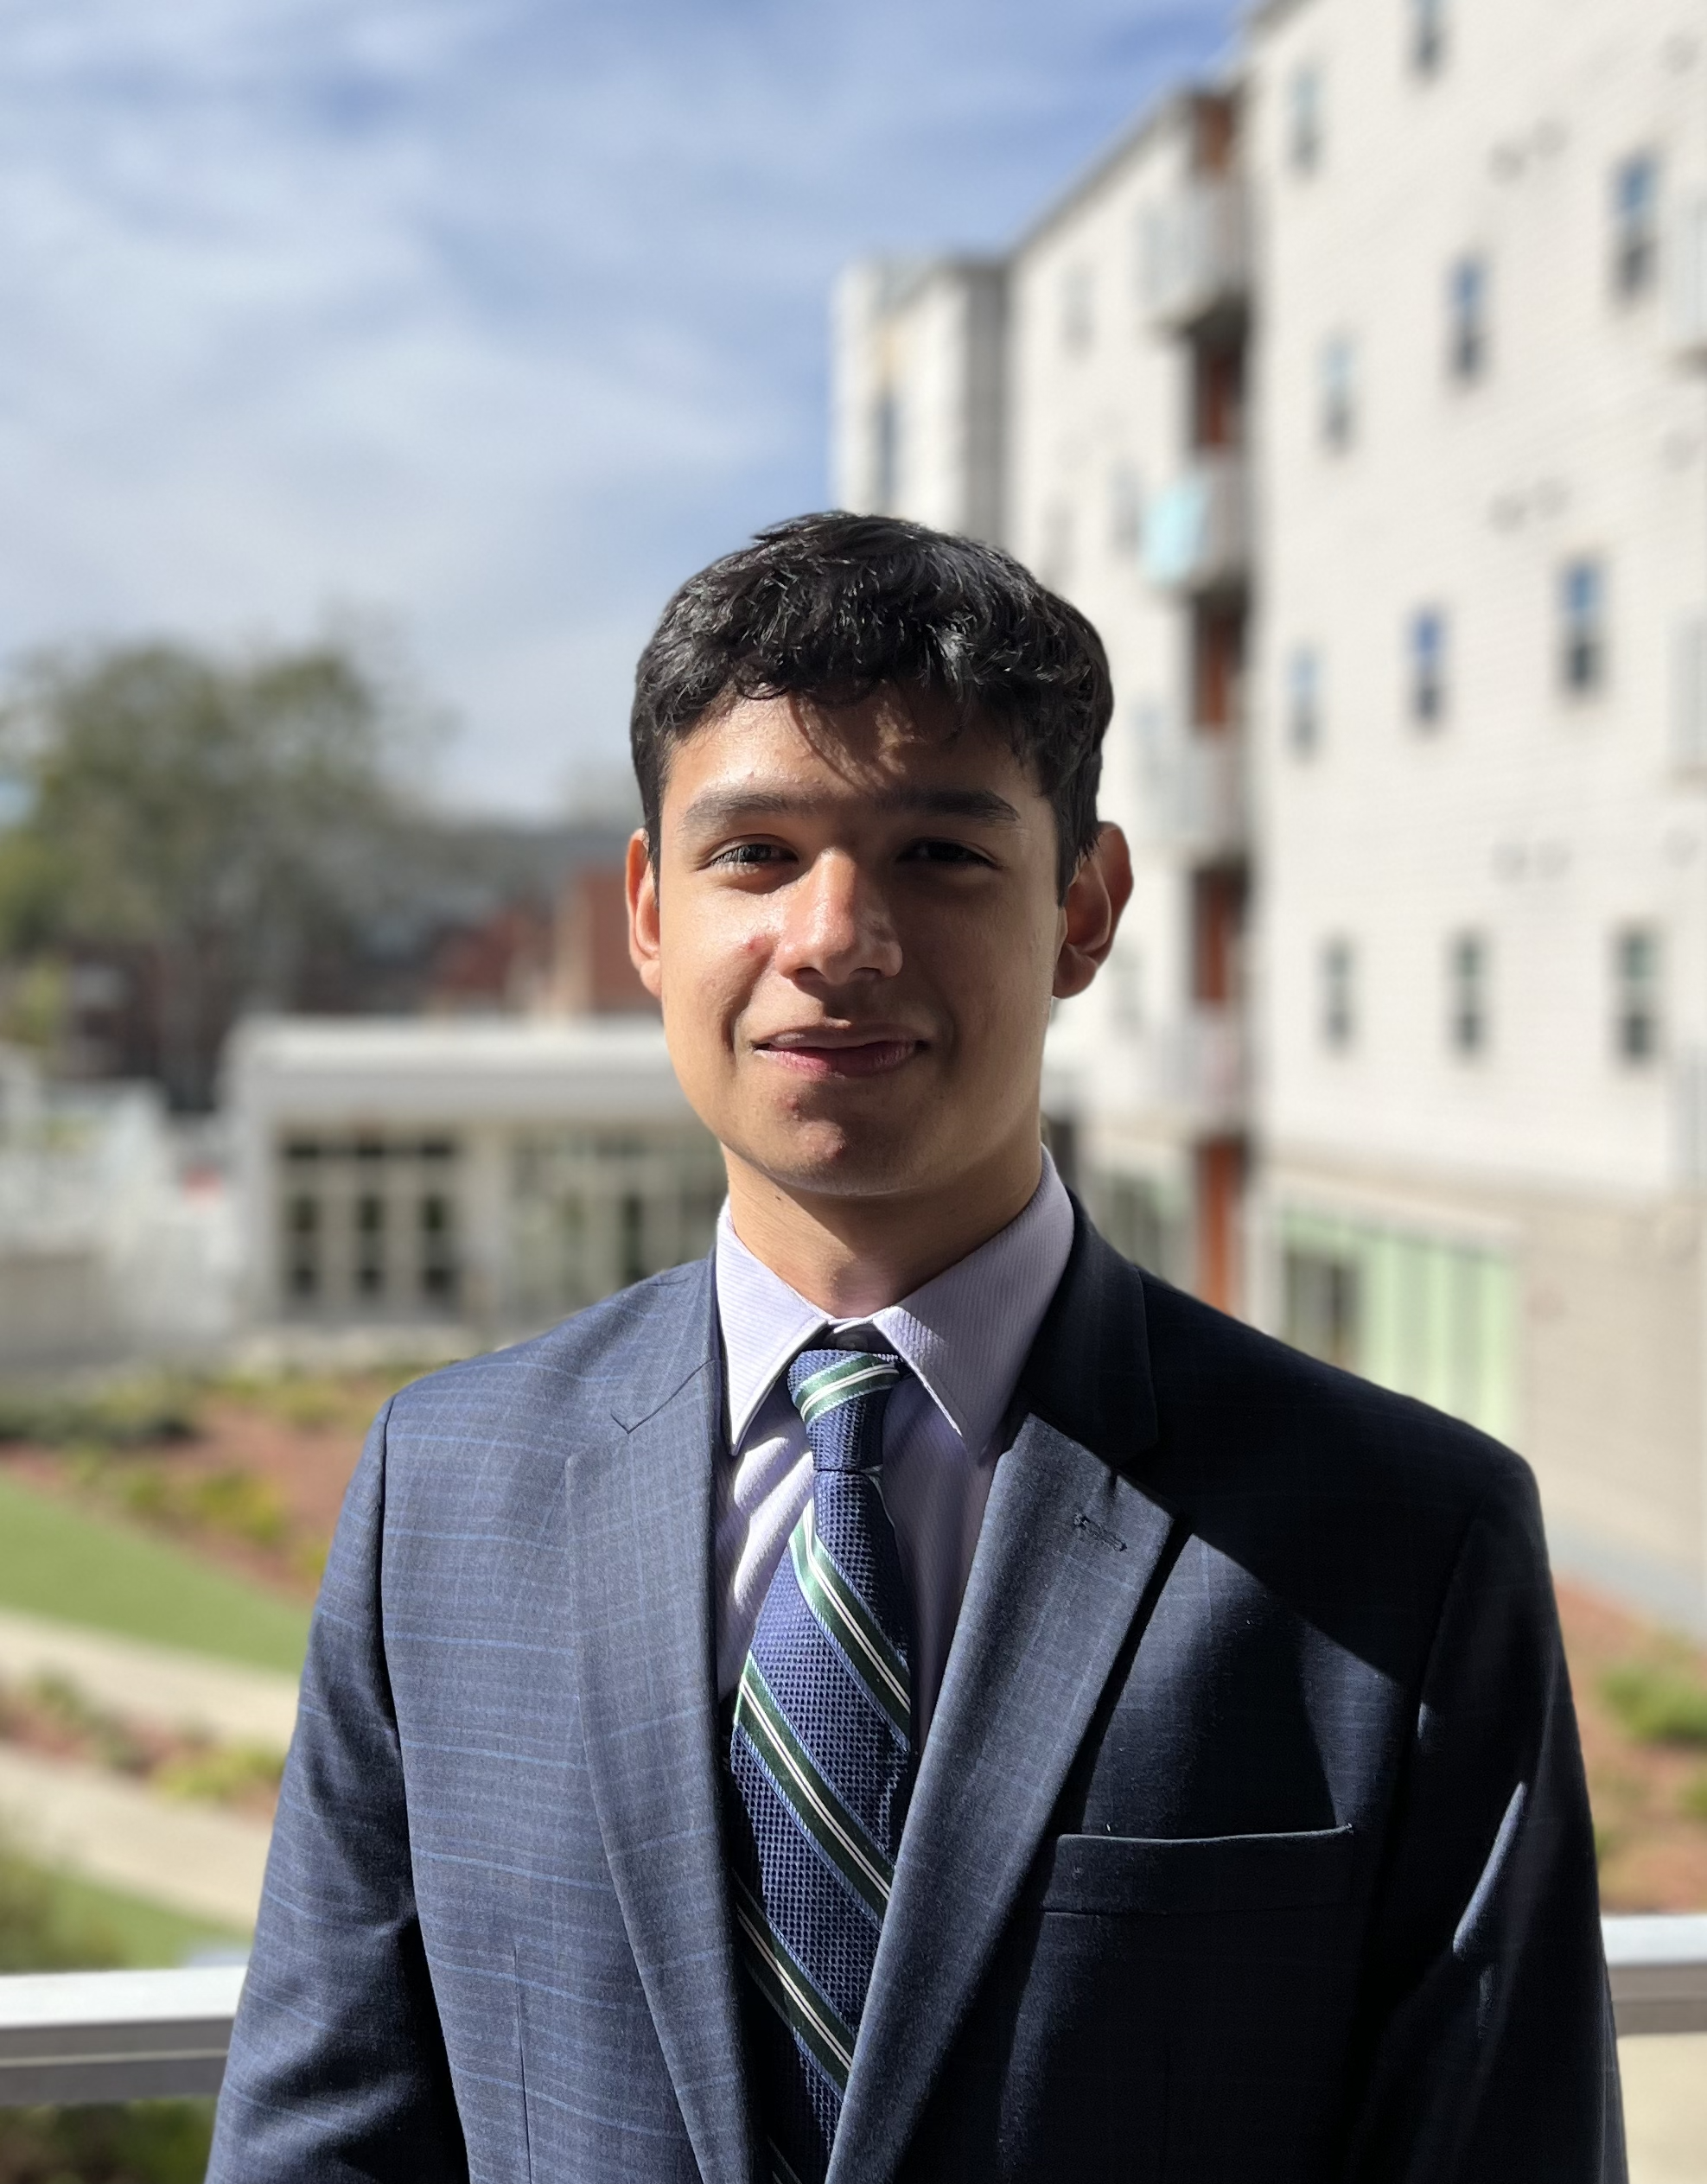
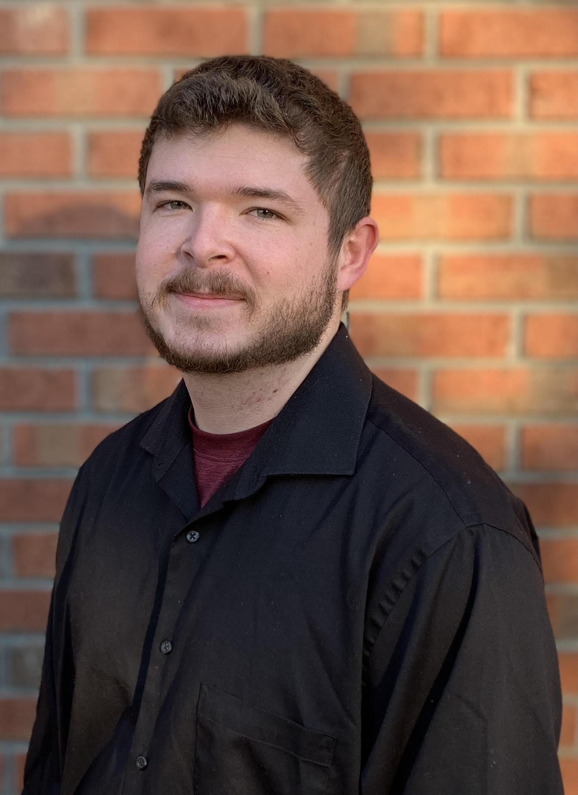
Team Overview
Cameron Barnes
Cole Gutknecht
Tyler Ince-Ingram
Rafael Meza
Michael Wyrick
Michael
Systems Engineer
Materials Engineer
Software Engineer
Dynamics Engineer
Design Engineer
Notes:
First we will start with some team introductions, My name is Cameron Barnes and I will acting as the team’s systems engineer, …..

Slide 3
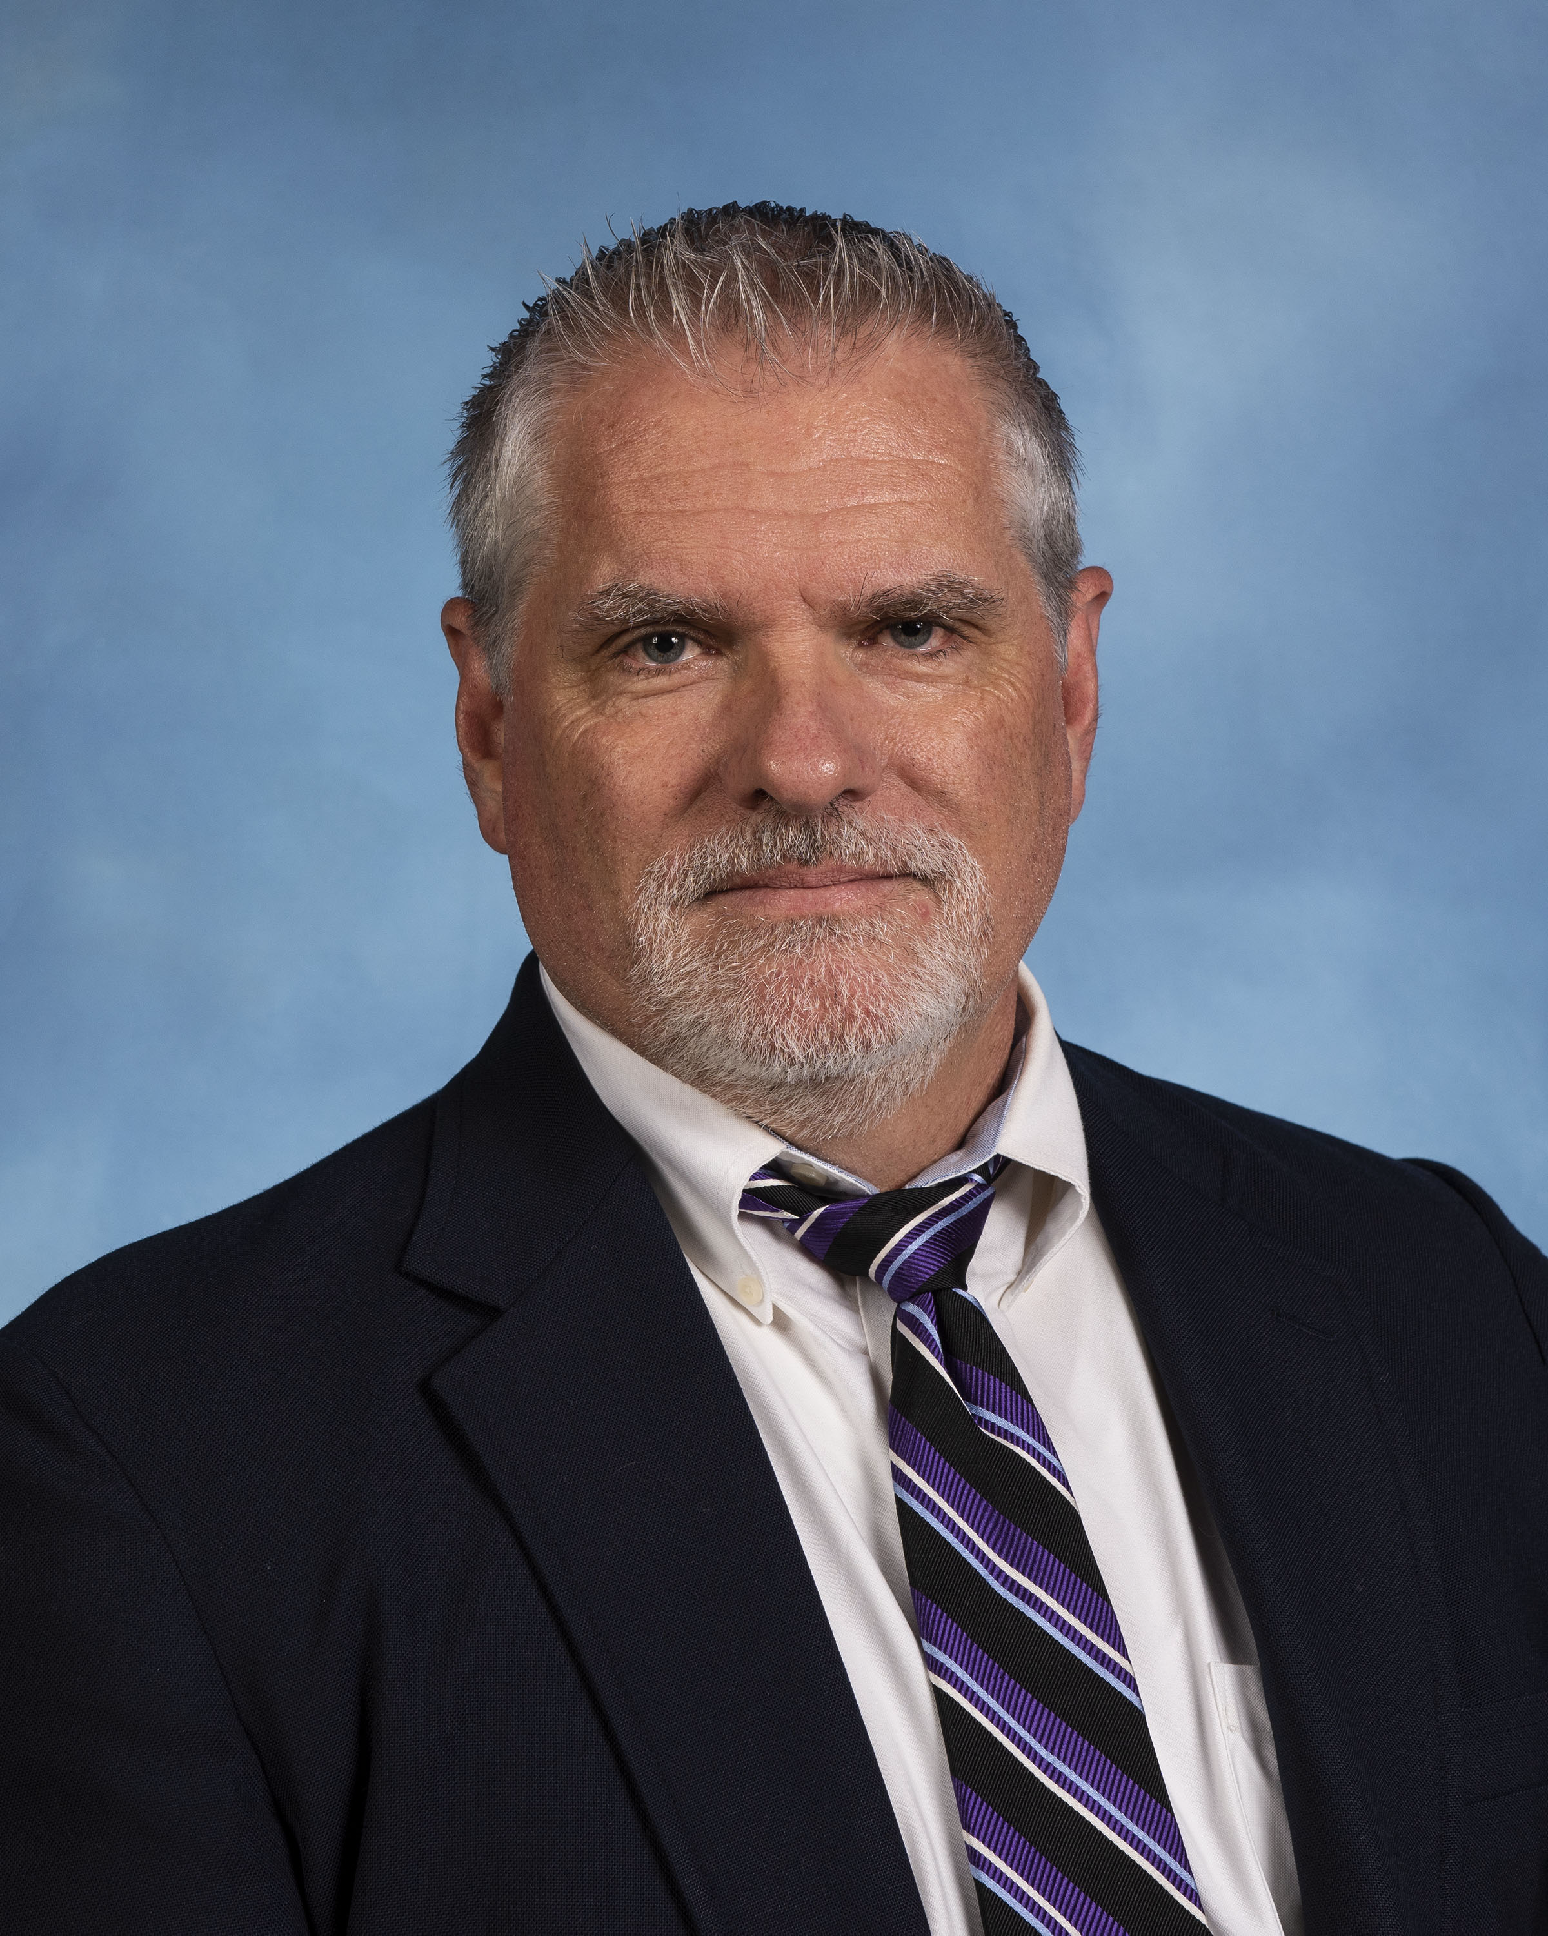

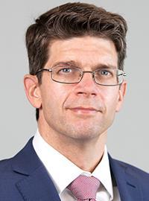
Sponsor and Advisor
Arthur Werkheiser
Dr. William Oates
Notes:
The sponsor for our project is Arthur Werkheiser, Deputy Branch Chief at Marshall Space Flight Center, acting as a liaison between our team and NASA. Our academic advisor is Dr. Oates who has research interests in Mechanics and Materials along with Non-linear control.

Slide 4
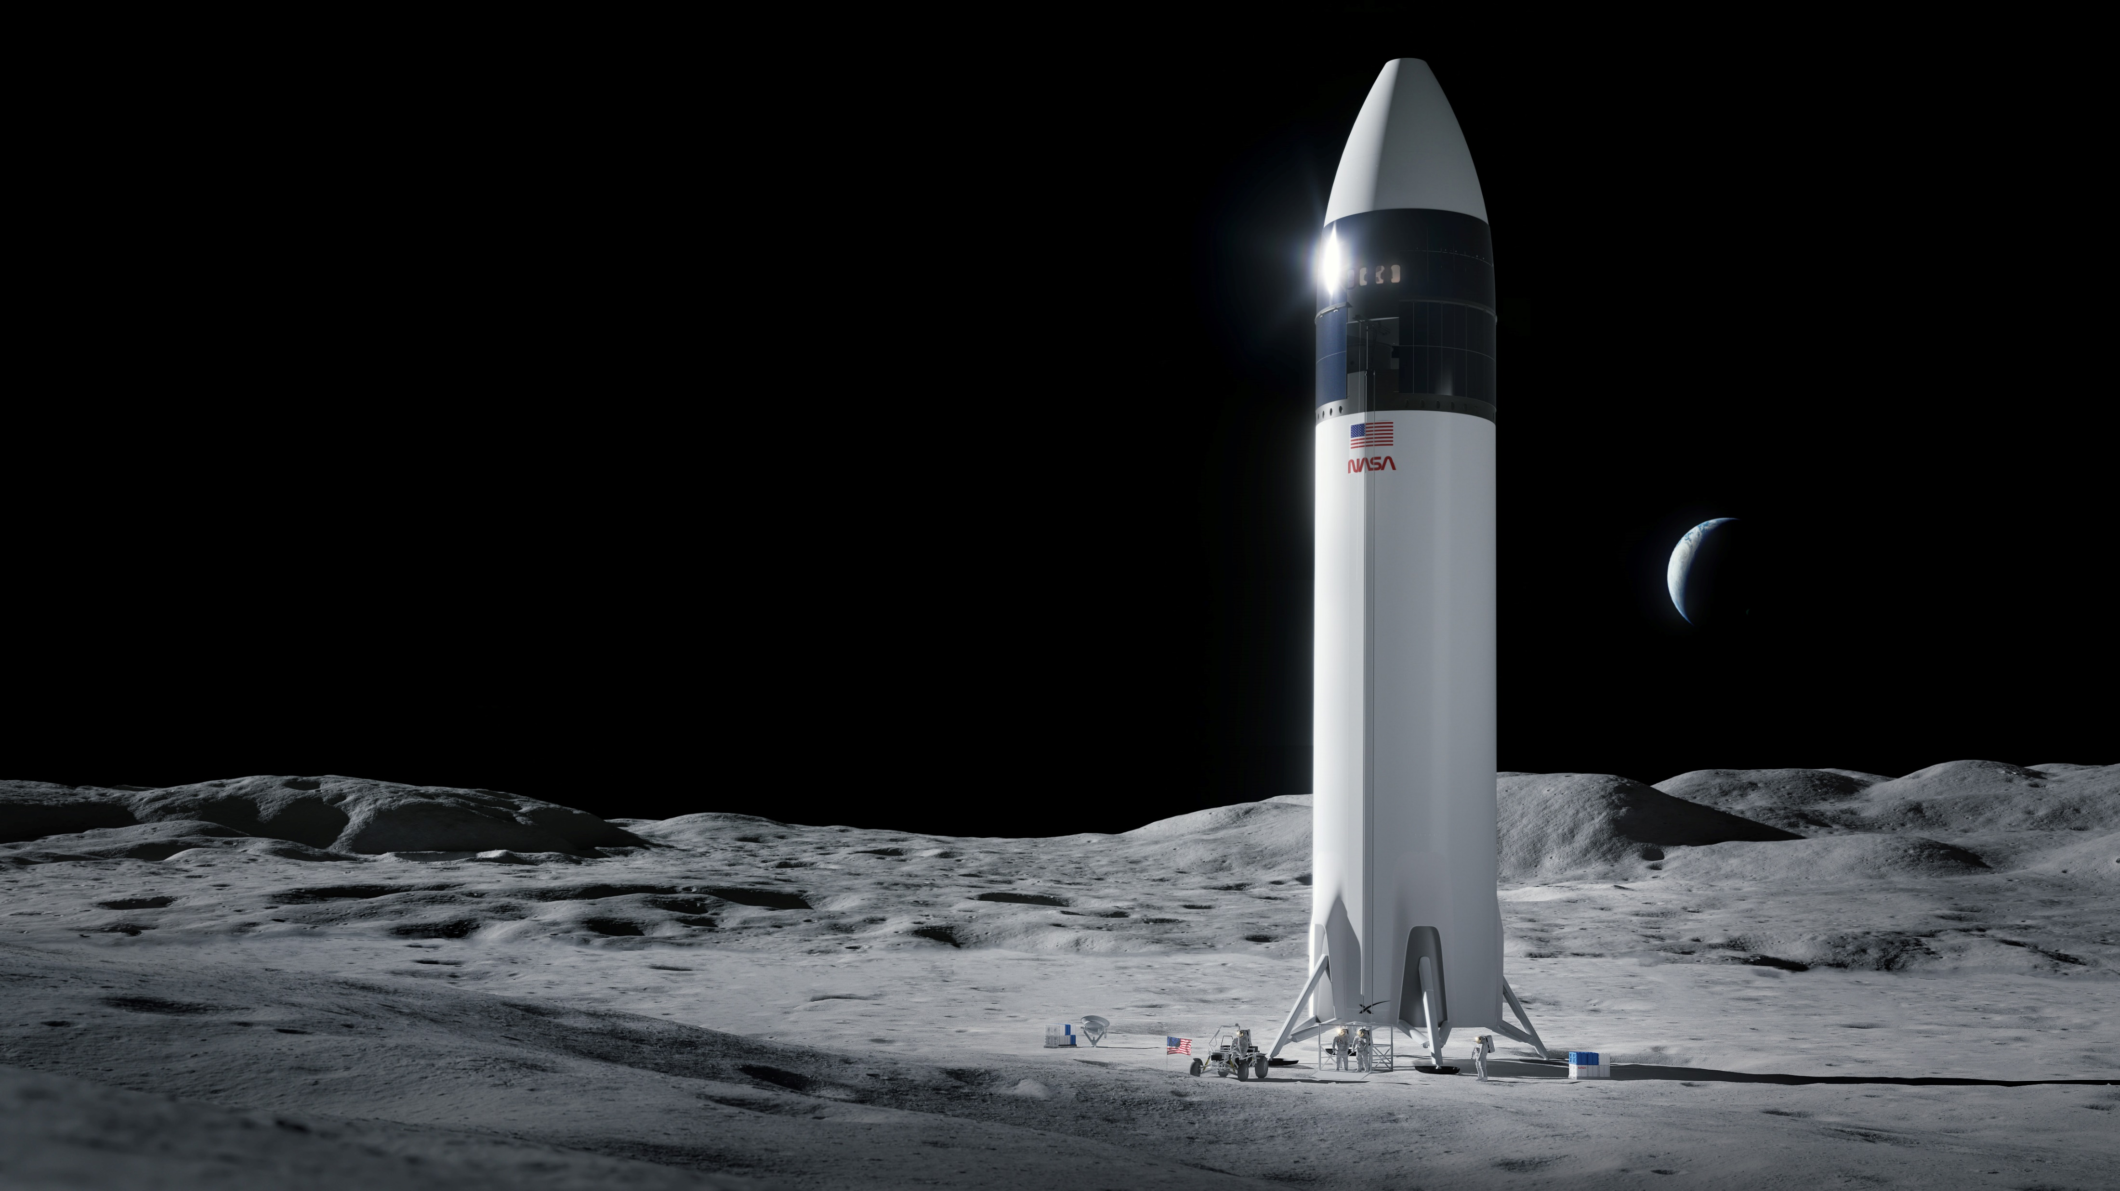
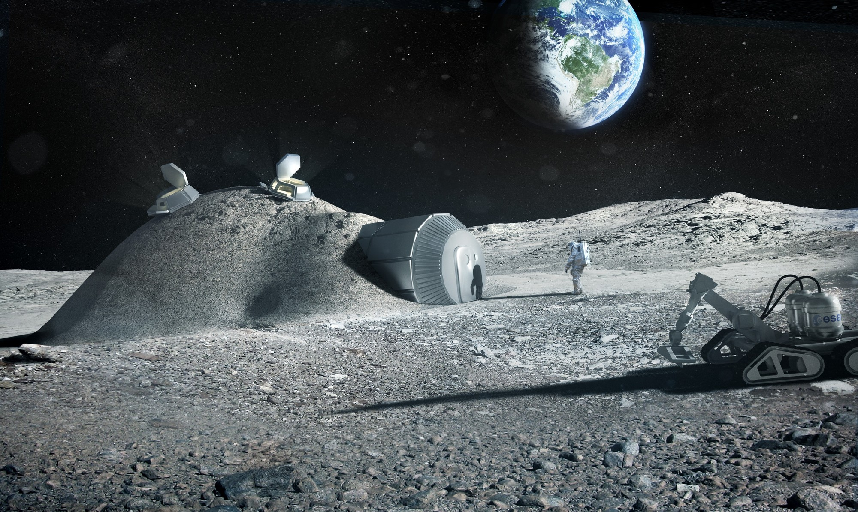
Project Description
Transport heavy loads on the lunar surface between the landing site and habitation area in support of NASA’s lunar development and expansion plan
Notes:
The objective of our project is to transport heavy loads on the lunar surface between an established landing site and habitation area.

Slide 5
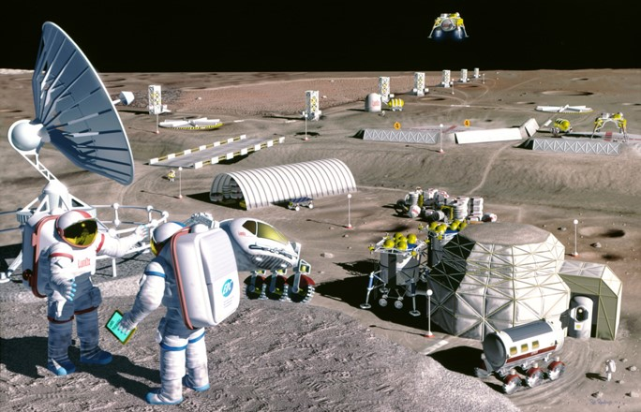

Background
Notes:
NASA’s Artemis project is the start of their plan for sustainable lunar development. The goal is that at some point in the future, we would have lunar bases and habitation areas acting as both scientific exploration centers and also a pitstop on the way to Mars. The plan is that these areas will have semi- self-sufficient since the most expensive part of space travel is getting from the earth to the moon in the first place, development efforts on the moon will keep cost down. However, some sort of device will be needed to help transport cargo around these habitats and also unload cargo from the nearby landing site which is where our device, which we are calling the Hermes transport vehicle, would come in.

Slide 6




Challenges
Rough
Terrain
Dust Mitigation
Temperature Extremes
Radiation
Notes:
Designing a device for the moon comes with a unique set of challenges:
The lunar terrain is harsh and rocky, consisting of small and large craters caused from millions of years' worth of Metroid damage. The terrain is also not flat so elevation change is common on the lunar surface.
Dust Mitigation/Regolith: The surface is coated in regolith, a layer of loose rock and dust that is extremely fine grained and abrasive. Additionally, it will kick up into dust plumes which will stick to all material.
The weather varies vastly depending on the lunar cycle. More concerning is the lunar night where the device must withstand extremely cold temperatures for 14 days.
Additionally, radiation can become a concern for our product, specifically the electronic components, overtime

Slide 7





Key Goals
Adaptable
Lightweight
Robust
Lifespan
Safe
Notes:
The following items are key design goals for our product. It must be lightweight, this is because reduction in weight translates to lower costs of delivery to the moon, therefore, with the cost of transport per mission being about $2.0 million per kilogram, so weight, mass, and volume are of the essence to make our design cost effective
It must be a robust design due to the previously discussed challenges surrounding the lunar environment and terrain, regolith and dust can be detrimental to the design if not adequately protected.
The design should have a level of adaptability for a variety of possible payloads with respect to size, shape, and mass.
Another goal for our product is that it will last at least one year on the moon to keep transportation costs again making it cost-effective and also to decrease the amount of lunar waste that would be produced from a short-term device.
All NASA and United States safety and technical standards are met as a baseline of safety for the operating crew and the environment. Additionally, NASA usually expects a factor of safety around 1.4,

Slide 8







Markets
Notes:
Since we specifically designing this device for NASA we have included them as our primary market but in the future our device could expand to many different aerospace companies such as SPACEX, Blue Origin, and variety of others.

Slide 9
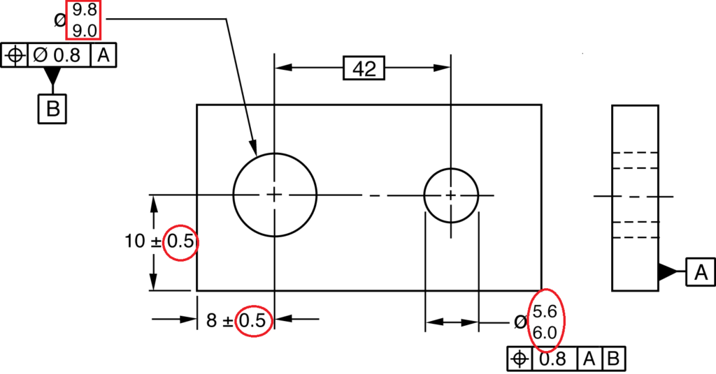
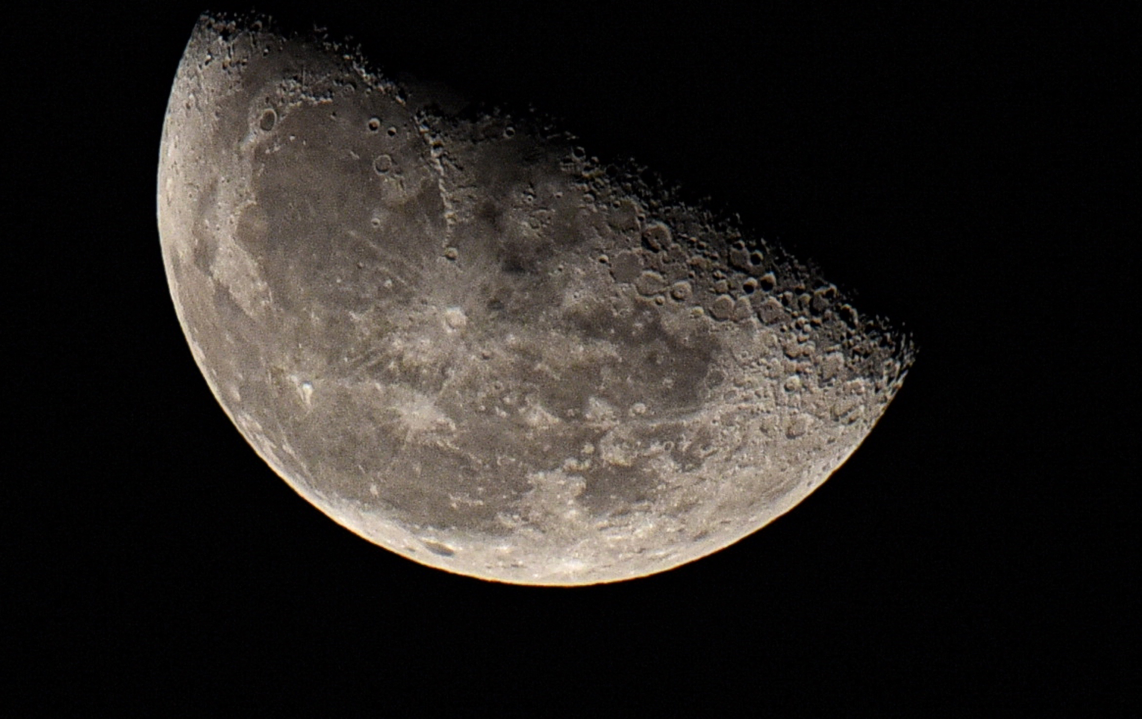

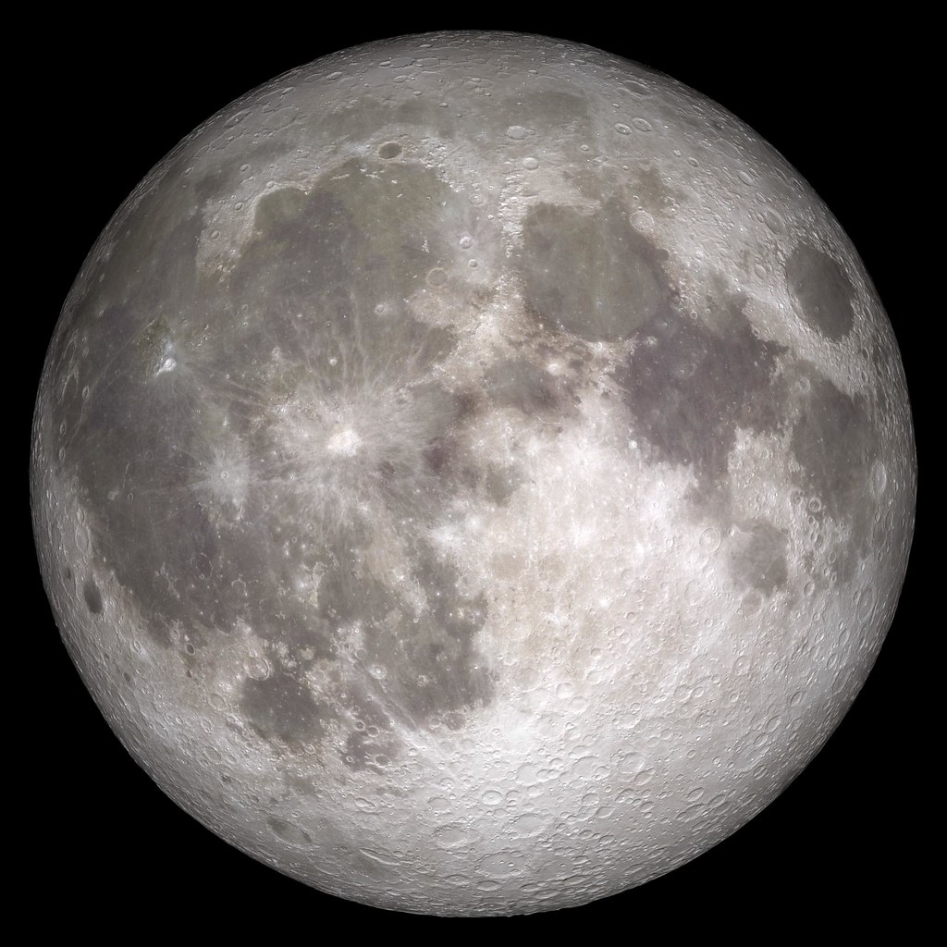



Assumptions
$$\frac{1}{6}$$
1
TON
TON
$$\frac{1}{6} TON$$
Notes:
the payload will have a maximum mass of 1 metric tons on Earth. This amount can be divided by 6 for lunar applications since the gravity is much lower than that one Earth (about 1.62 m/s^2)
The system will be built with loose tolerances to keep cost low and to help with dust mitigation efforts. However, this should not take away from the device functionality.
???? Idk ---low cost, help with dust (robust)
it is assumed the device should survive the lunar night, but there is no requirement for it to transport loads during that time.

Slide 10
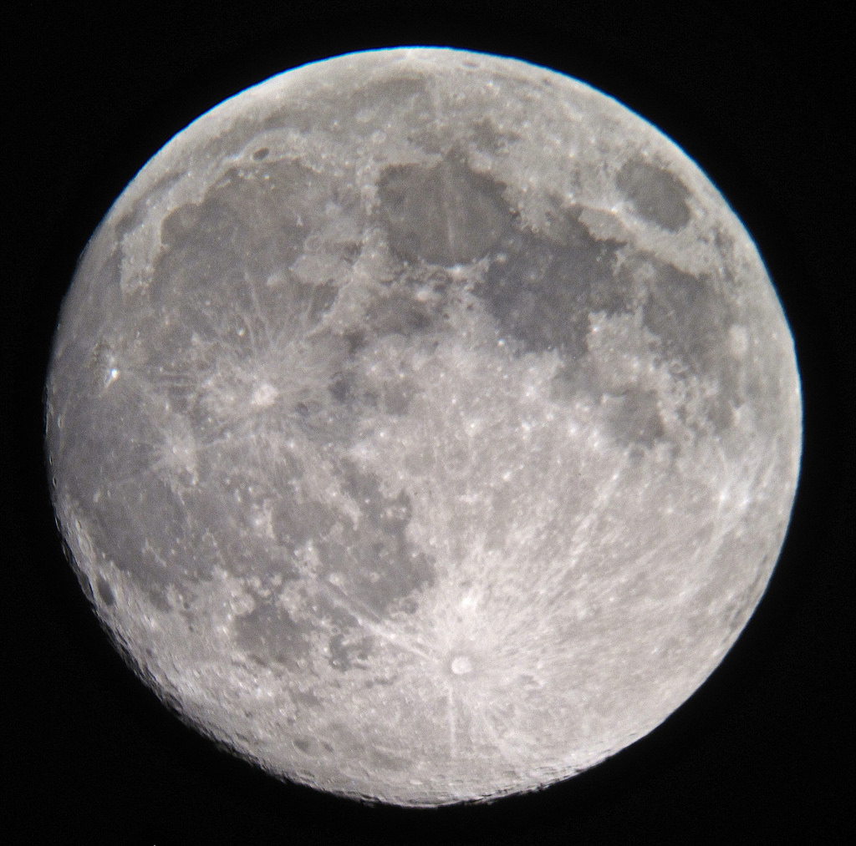


Assumptions
1 km
*Not drawn to scale
Notes:
The landing site of the aircraft should be within 1 km of the habitation area where the cargo will be deposited. Preferably our device could travel longer distances but it should at a minimum be able to travel this kilometer.
It is assumed the device have to withstand temperatures ranging between 140 K (~133.1℃) and 400 K (~126.8℃). This accommodates the temperature for both the periods of lunar night and day. This also assumes our landing site to be far away from the significant weather extremes of the polar regions where temperatures can drop to around 20 degrees kelvin.
It is also assumed that the materials purchased will be budget-friendly. The end product will be an earth-bound prototype and we will be buying materials suitable to this application.

Slide 11

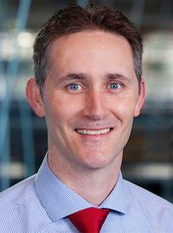

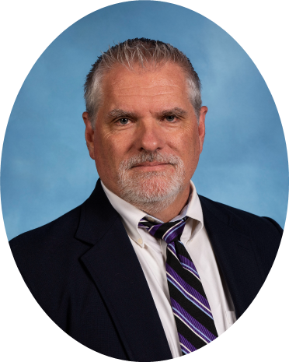
Stakeholders
Notes:
The stakeholders for our project includes NASA as they are sponsoring us and indirectly congress who approves NASA’s budget expenditures. Additionally, people who have both interest and control in our project include Dr. McConomy, Dr.Oates, and Arthur Werkheiser.

Slide 12
Customer Needs
Design will primarily focus on transporting heavy loads
The movement speed of the device can be relatively low (6-8 km/hour)
The power system must handle long distance travel while being adaptable based on the required exertion of the device
Ideally fully autonomous when traversing the lunar surface, but human operation is acceptable.
Assistive mechanism facilitating human operators when they attempt to load the device
Notes:
After coming up with a series of questions for our project sponsor and conducting an interview, we gained a sense of what the requirements for this project would be based on their responses, and we pulled out some of the key takeaways from this discussion.
1. Our primary objective is to successfully transport heavy loads
2. The speed we operate at must be able to cover 1 km in 10 min at least, which is why we chose the relatively low range of speeds
3. Our device must travel long distances and we need an adaptable power system to support that requirement
4. For the purpose of our project, we will be focusing on the human operation aspect rather than autonomy due to time and budget constraints and to limit scope creep.
5. In order to assist human operators, a lifting mechanism should be in place to support them when loading cargo.

Slide 13




Functional Decomposition
Survivability
Power
Activation
Structural Design
Notes:
Through Functional Decomposition, our team was able to break down our device into the following 4 major functions and then into simpler components to first reduce the complexity of the entire system and to help our team understand what our device must do in order to be considered successful.

Slide 14
Functional Decomposition
Temperature Resilience
Maintains Structural Integrity
Dust Mitigation
Prevents Joint Breakdown
Survivability
Radiation Tolerance
Protects Electrical Components
Notes:
Survivability focuses on the ability for our device to tolerate or resist the harsh environmental conditions on the lunar surface, and we broke it down further to understand how these conditions would affect the various components we would have.
Temp. Resilience – Since we have to account for the temperature differences on the lunar surface, materials will experience temperature strain and we want to plan accordingly to what materials we choose to purchase
Dust Mitigation – We chose this to focus on preventing the deterioration of our vehicle’s joints and protecting the electrical components, For instance, with lunar regolith since it is a very abrasive material and tends to stick to objects this would cause degradation to occur on the materials and eventually lower the life span of our device.
Radiation Tolerance – Since the temperatures on the moon can reach 400K being mindful of how the efficiency and functionality of our electrical components will be affected is of importance

Slide 15
Functional Decomposition
Subsystems Power
Energy Collection/Storage
Smart Energy Usage
Primary Systems Power
Load Based Power Variability
Transmits Power
Generates Torque
Power
Notes:
The focus of the power system will be the collection and storage of energy while also having an adaptable control system, this control system will be needed to manage power output to the primary systems and subsystems based on the load that is being carried. This system will also focus on the transmission of power to generate a high amount of torque to successfully transport various loads to a specified area.

Slide 16
Functional Decomposition
Lift Assist
Lifting Mechanism
Pathing Technology
Mobility
Activation
All Wheel Control
Notes:
Activation deals with the mobility of both vehicle transportation and the lifting assistance. With the lifting assist, having a modular system would be beneficial to account for the various types and sizes of cargo and since humans will be in space suits there will be reduced grip strength, and overall the device movement will rely primarily on the pathing technology and all wheel control when navigating through the lunar surface.

Slide 17
Functional Decomposition
Fit
Conforms to Cargo Space Requirements
Packaging
Suspension
Structural Design
Stability
Traction Control
Notes:
Structural Design takes into consideration fit, packaging and stability in order to ensure the device conforms to the cargo area of a rocket when it is time for a mission, it can securely store cargo and transport it in a stable manner due to the unevenness in terrain of the lunar surface, having this stability will help prevent loss or damage of this cargo as it approaches a designated area.

Slide 18
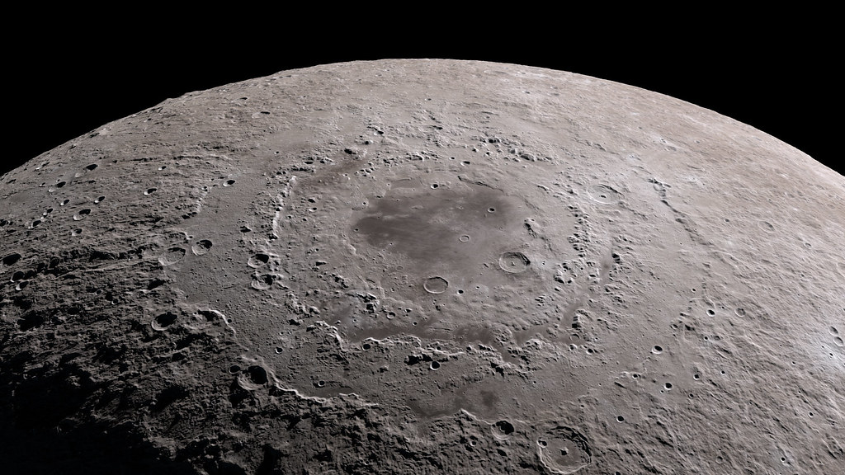

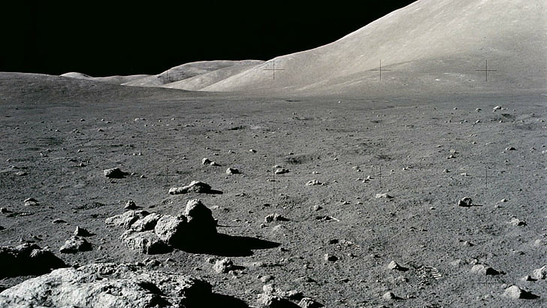




Functional
Resolution
Assist in Lifting
Power
Transport
Environmental
Tolerance
Notes:
Transporting heavy loads is our main objective
All of the other functions such as power, environmental tolerance and lift assist will be considered as key constraints because they are important for the purpose of this project and will be accounted for when building our final prototype but might not be fully operational by April. However, for functions such as power, the bare minimum should be met so that the device can be operational and undergo testing. The reasoning for this is to focus our efforts on the primary objective and not let other aspects creep in and cause us to stray away from our main goal.

Slide 19
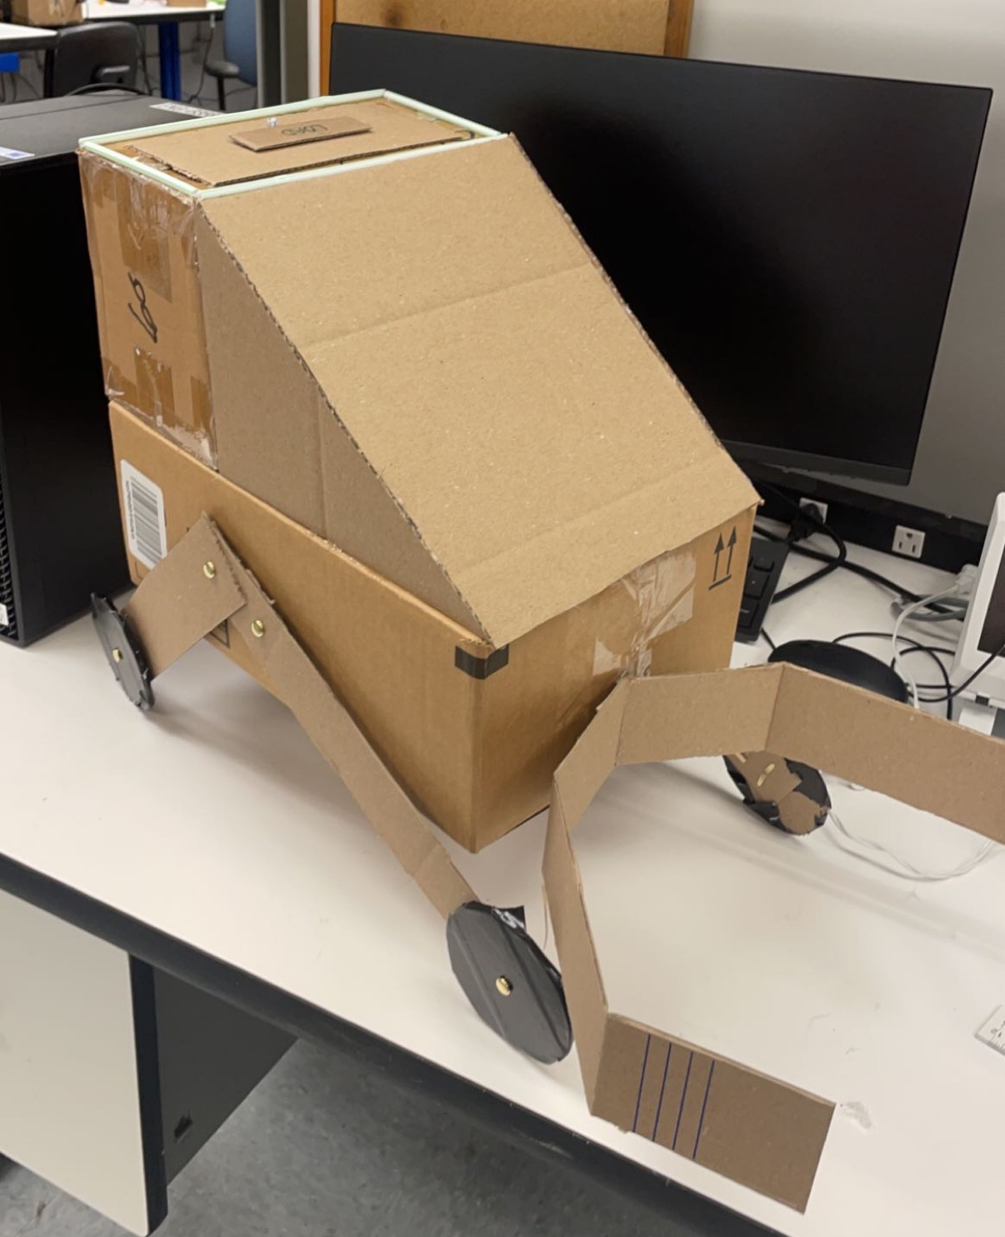

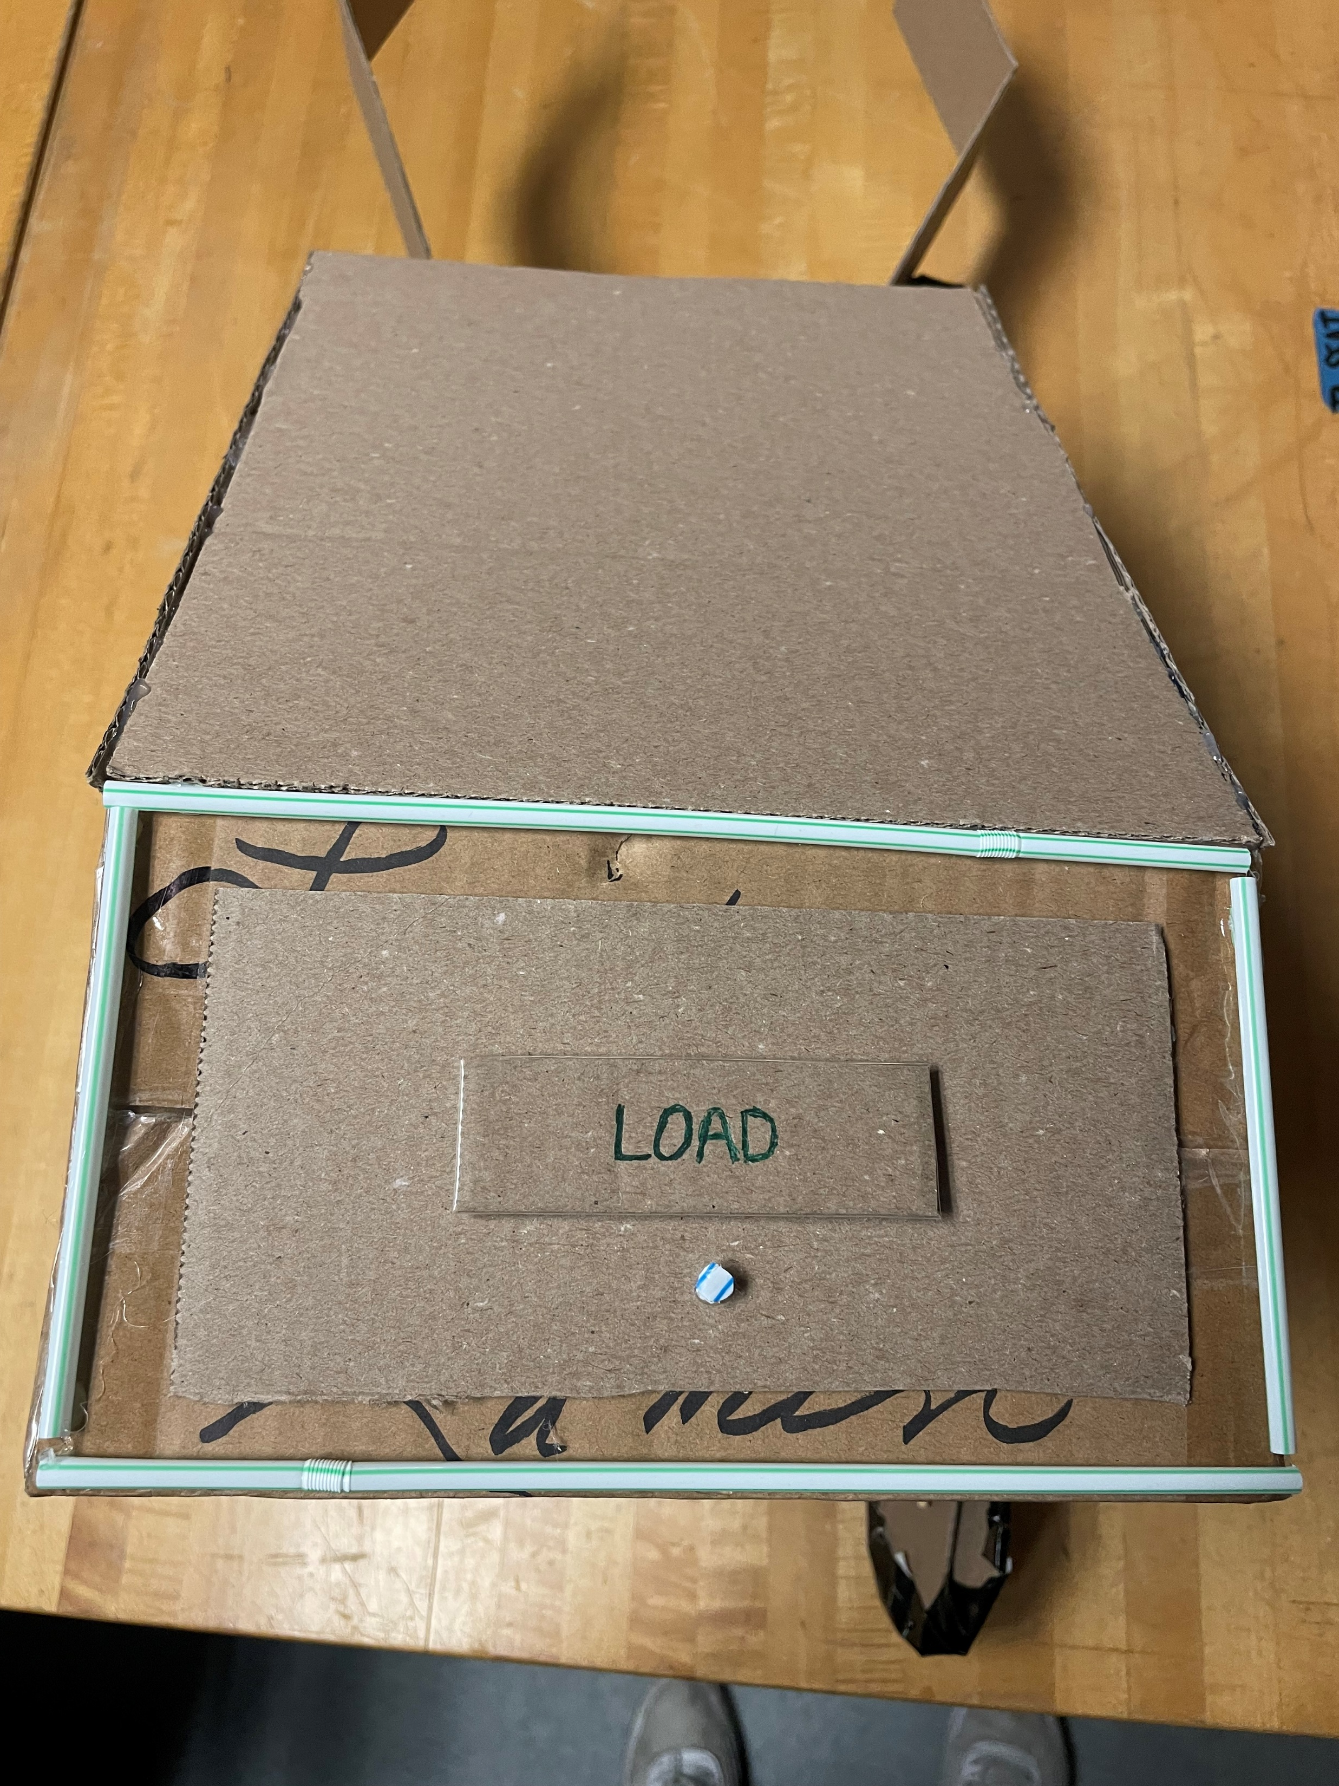


Mechatronics Prototype
How it Helps:
Mobility
Distance/Position Awareness
Obstacle Awareness
Notes:
Up until this point in our project, we have created a preliminary mechanical prototype that we are using to begin some of the basic mechatronic aspects of our device. This device will move by line following and will sense when an object is in its path using 2 infrared and 1 ultrasonic sensor. When it gets close enough to the object it will stop and determine if this load is something it needs to lift or not through either color sensing or an attached camera. If it does, It will output the coordinates of the object, through the use of an accelerometer, and grab the object and possibly reverse back to the original base point with the object in its grip.
This will handle some of the mobility, distance, and obstacle awareness features that will be present within our final design.

Slide 20
Future Work
Targets and Metrics
Concept Selection and Generation
Risk Assessment
Modeling
Notes:
Looking ahead these are the next steps our team will be focusing our efforts on in order to close out the first semester of this project successfully.

Slide 21
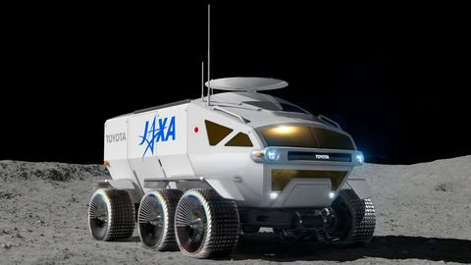
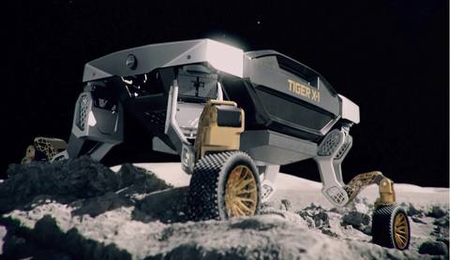

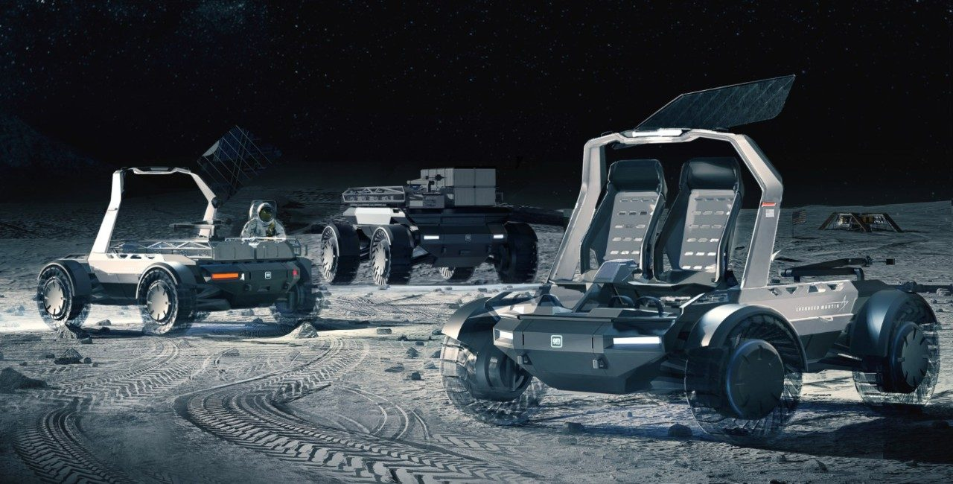
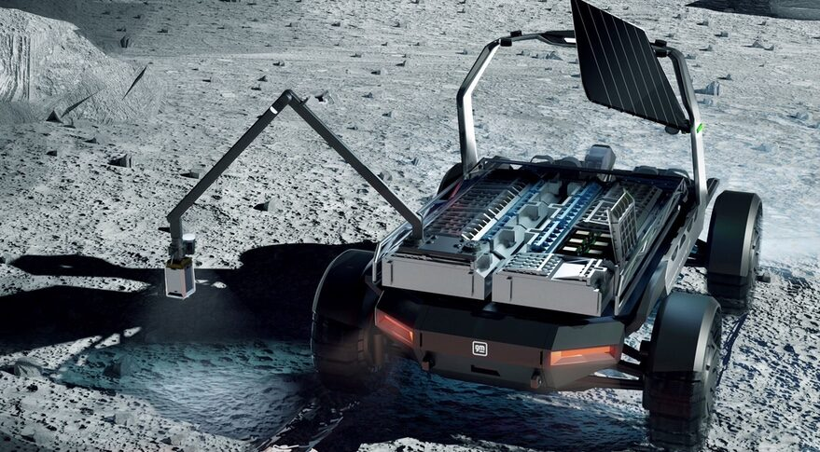
Conclusion
Notes:
By April we should have a testable Earth-bound prototype.
This prototype will be expected to transport a designated load
Other functions such as power, environmental tolerance, and lifting assist will be treated as key constraints for the vehicle. They will be included in our final poster visual and may be added to the device prototype for example purposes only (such as with the power system we would have mock solar panels that are showcased but will not be operational due to the scope of our project)
And with that I’d like to open the floor to any questions

Slide 23
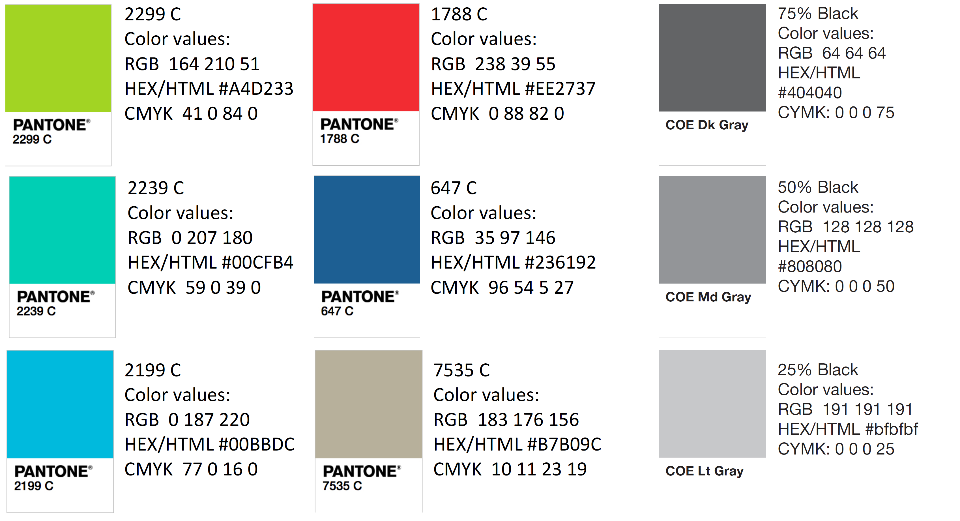
Color Palette
How do you think current control surfaces and their actuation can be improved? | Current control surfaces require clean flow, which is not realistic at high angles of attack, so that’s something. | Projectile accommodates for attached flow over control surfaces.
What draw backs come with standard fin deflections as a control surface? | Must have clean flow to actuate properly. Size and weight that come with actuation mechanism | Projectile control surfaces will be suitable effective even in detached flow.
What Mach numbers would be expected for this projectile? | FCAAP polysonic wind tunnel can’t go faster than Mach 5. We’ll probably test Mach 4. | The projectile can withstand Mach 4.
What slenderness ratio of the projectile would be appropriate? | Would be nice if it could be tied into what we have done already. Matching a baseline design here at FCAAP. 8-10 | The projectile uses a basic axisymmetric body configuration based on previously tested models.

